Slide 1
24-623: LAMMPS Lecture 3/8/2011

Slide 2
Outline
LAMMPS Overview
LAMMPS Installation
LAMMPS Example How to Run
LAMMPS Example Code
LAMMPS Example Results
LAMMPS Performance
LAMMPS Modifications
LAMMPS Post-Processing
Discussion

Slide 3
LAMMPS Overview
LAMMPS = “Large-scale Atomic/Molecular Massively Parallel Simulator”
http://lammps.sandia.gov/
FEATURES:
LAMMPS has many potentials, including potentials for biological systems, colloids, granular materials, metals, etc.
LAMMPS has many built in functions (computes) that can automatically calculate/average quantities (Temp., Press., MSD of atoms, RDF, thermal conductivity, etc.).
LAMMPS is an open source code in C++. Anyone can modify the code. Older versions in F90/F77 are available as well as Windows version.
LAMMPS is a parallel code. It can be run on single cpu or in parallel using MPI and spatial-decomposition of simulation domain.

Slide 4
LAMMPS Overview
With respect to Wissam’s Lecture:
LAMMPS is a CLASSICAL code! Can do 10⁵ – 10⁶ atoms for 10-100 ns.
I need interatomic potentials (don’t exists for every system).
Compare to DFT based methods: O(100) atoms, 10s-100s ps.
No need for interatomic potentials.
One way these methods work together: take calculations from DFT and fit to interatomic potentials. Everyone wins.

Slide 5
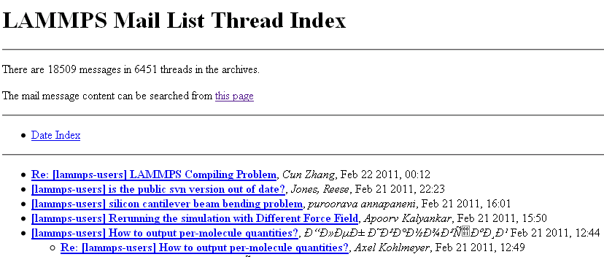
LAMMPS Overview: Support
LAMMPS has an excellent mailing list that began in 2005 and has >10,000 messages. Probably the best discussion forum I’ve seen of all open source simulation codes.
http://lammps.sandia.gov/mail.html
Major Contributors:
Steve Plimpton: staff member at Sandia Nat. Lab. http://www.sandia.gov/~sjplimp/
Axel Kohlmeyer: Professor at Temple Univ. http://sites.google.com/site/akohlmey/
You!

Slide 6
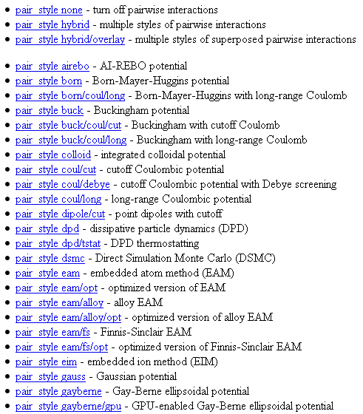
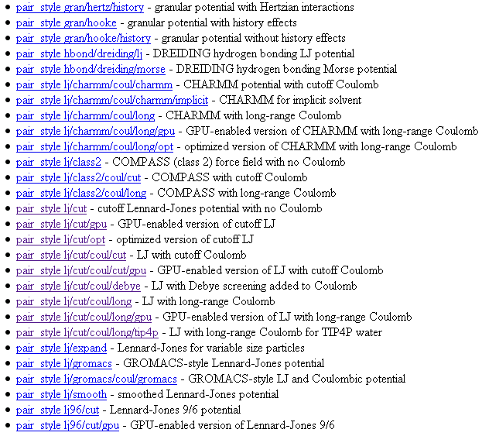
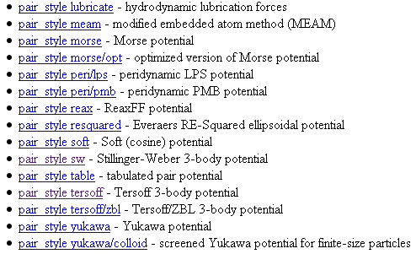
LAMMPS Overview: Potentials
Most of these can be combined in a “hybrid” style
Additionally, users can enter in potentials numerically or by writing a new module to LAMMPS

Slide 7
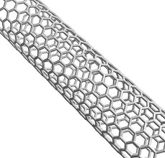
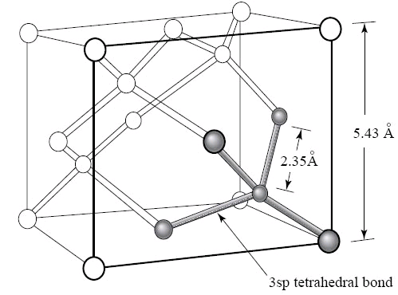
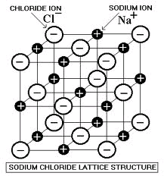
LAMMPS Overview: Potentials 2
FEATURES:
Potentials for “soft” materials (biomolecules, polymers):
- Can simulate Colloids, bonded organic molecules, granular materials, etc.
Potentials for “hard” materials (CNTs, Si, Metals, LJ, Charge):
pair_style airebo - AI-REBO potential
Can simulate CNTs/hydrocarbons:
pair_style sw - Stillinger-Weber 3-body potential
Can simulate Si/Ge:
pair_style coul/long - long-range Coulombic potential
Can handle Coulomb, from Class:

Slide 8
LAMMPS Installation
LAMMPS can be downloaded from:
http://lammps.sandia.gov/download.html
Includes the current “build” (with both serial and parallel capabilities) and older builds.
Also available are Windows serial and parallel versions:
LAMMPS can be “installed” in Windows using Cygwin: http://www.cygwin.com/
Linux
The current “build” has the most recent functionality. Consequently, it may be incompatible with old compilers/libraries.
Needed:
Serial
Desktop PC running (almost) any Linux OS.
C++ compiler (GNU gcc or Intel icc): GNU installed by default in almost every Linux OS.
Parallel
Parallel computer (Cluster, GPU, etc.).
MPI library (openmpi, impi, mpich) for parallel code: Mpich and openmpi installed by default on most computing clusters.

Slide 9

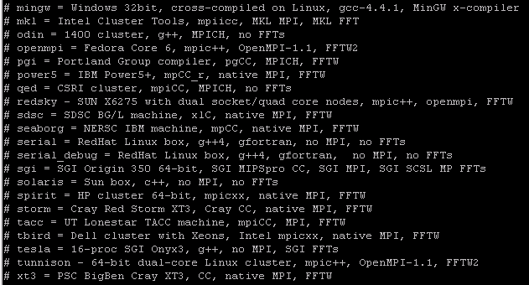
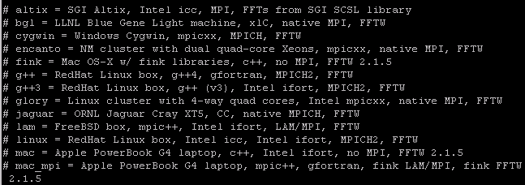
LAMMPS Installation 2
Detailed instructions here:
http://lammps.sandia.gov/doc/Section_start.html
root@jason-desktop:/home/jason/lammps# tar xvf lammps-18Aug10.tar.gz
- This unzips the LAMMPS program files to a folder called “lammps-18Aug10”
root@jason-desktop:/home/jason/lammps# cd ./lammps-18Aug10/src
- This moves to the “src” folder which has the source code files. Once here, there are a few options. To compile the code type:
root@jason-desktop:/home/jason/lammps/lammps-18Aug10/src# make machine
Where machine can be:

Slide 10
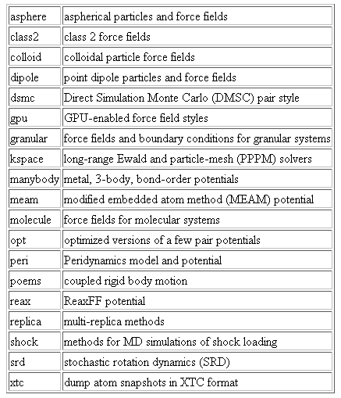
LAMMPS Installation 3
The previous section will make LAMMPS with the standard “packages”. Additional packages can be included/excluded during installation, but may require additional libraries (fft, etc.).
This customizability ensures that LAMMPS (in one form or another) can be run on virtually any computer.
Result should be an executable located in the src/lmp_machine, where machine depends on how you compiled (for me it’s lmp_openmpi).

Slide 11

LAMMPS Example: How to Run
Steps:
Set your path to the location of the LAMMPS executable:
export PATH = /home/jason/lammps/lammps-16Apr10/src
In this “./src/” directory is the LAMMPS executable. For me: “/src/lmp_serial”
Put the example files into a directory, say:
/home/jason/lammps/LJ/0press_alat
Input Script Input Structure
3) Run the executable with:
This command runs LAMMPS in background and gives you back control of the command
terminal. Type “top” to check if LAMMPS is running:

Slide 12

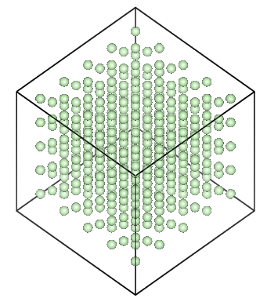
LAMMPS Example Code
Input file (has MD information): in.LJAr.alat Input Structure: LJ.4x4x4.in.data
What happens:
Measures 0 pressure lattice constant (alat) for 4x4x4 supercell of FCC Ar (256 atoms) using NPT ensemble.
Measure constant volume specific heat using formula:
Do 1) and 2) for T_run = 10...80K
Repeat for T_run
NPT heat to allow cell expansion to 0 Press at T_run.
NPT data collection to measure <alat>
NVT to measure cv

Slide 13
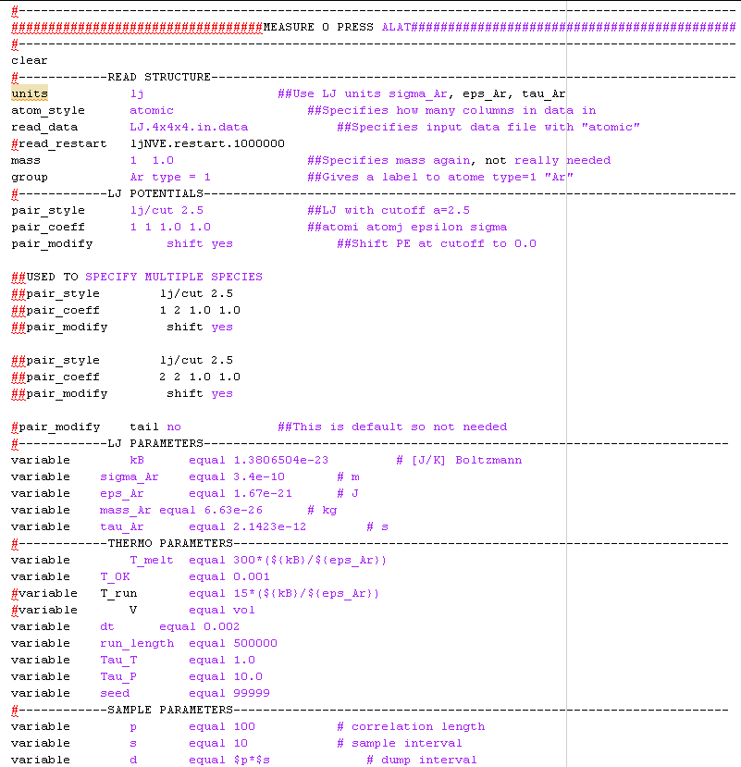
LAMMPS Example I
in.LJAr.alat
What happens:
Input structure
Interaction potential
Simulation variables
Continued…

Slide 14
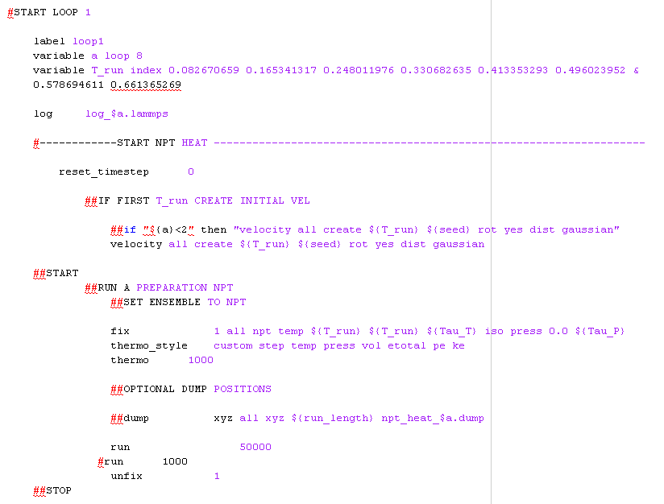
LAMMPS Example 2
What happens:
Run an NPT to initialize
Continued…

Slide 15
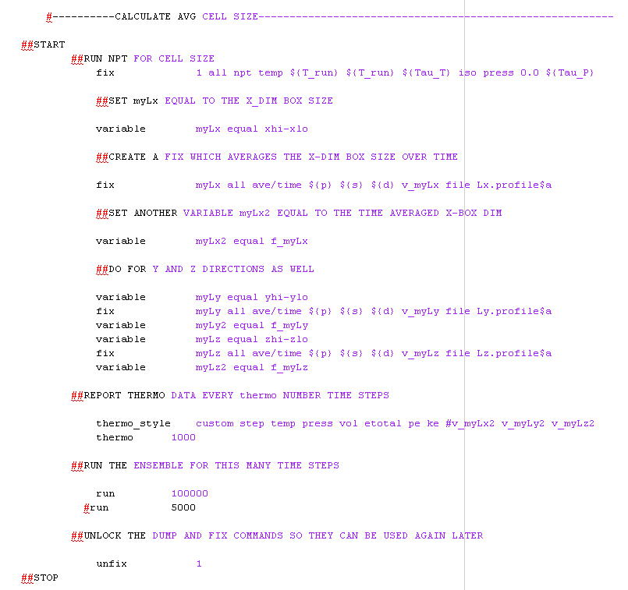
LAMMPS Example 3
What happens:
Run in NPT
Time average Lx, Ly, Lz
Continued…

Slide 16
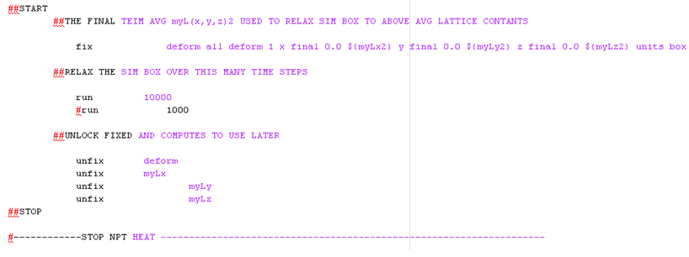
LAMMPS Example 4
What happens:
Sim. Box dimensions are changed to <Lx>, <Ly>, <Lz>
Continued…

Slide 17
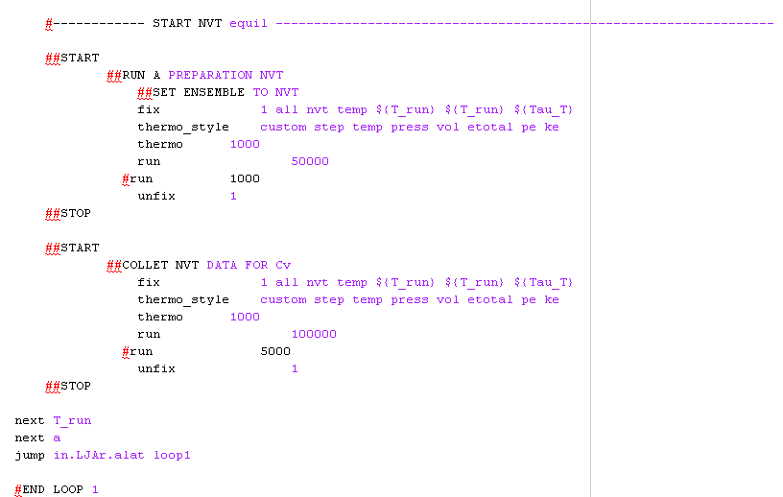
LAMMPS Example 5
What happens:
Short NVT run to initialize.
Data collection NVT run to measure Cv
Loop ends for given T_run, starts over.
END

Slide 18
LAMMPS Example Results
Explanation for differences:
Thermo sampling rate (more data to average cv).
Average over different initial conditions (how could you do this?).
Vary tau_T to see if this has an effect.
Increase the equilibration times between NVT and NPT data collection segments.
You can easily automate all of these
(and much more).
BONUS: can someone explain why cv would be different than 1 in a classical system?

Slide 19
LAMMPS Examples
There are many examples of LAMMPS used in publications here:
http://lammps.sandia.gov/papers.html
Also many short clips of examples:
http://lammps.sandia.gov/movies.htm

Slide 20
LAMMPS Performance
Using the Lecture Example code, I get the following performance:
LAMMPS:
Ubuntu 9.0, 2.0 GHz CPU, 1 GB RAM, 256 atoms, NPT, neighbor listing:
Rate = 1000 steps/s
Larger systems will scale N*rate because of neighbor listing. Can be even faster using parallel
capabilities.
My LJ Code:
Ubuntu 9.0, 2.0 GHz CPU, 1 GB RAM, 256 atoms, NPT, NO neighbor listing:
Rate = 70 steps/s
Larger systems will scale as ~N^2 since no neighbor listing.

Slide 21
LAMMPS Modifications
This section describes how to add/modify the LAMMPS source code:
http://lammps.sandia.gov/doc/Section_modify.html
LAMMPS is designed on a modular fashion using C++. http://www.cplusplus.com/doc/tutorial/
- Hi-level structure uses classes, functions are class methods and use simple array, vectors, numbers. http://www.cplusplus.com/reference/stl/vector/vector/
Creating a new class requires new.cpp and new.h. Best way to understand is to look at existing classes (like compute_temp.cpp and compute_temp.h). http://www.cplusplus.com/doc/tutorial/classes/
If worthy, new features are encouraged to be submitted to LAMMPS developers.

Slide 22
LAMMPS Matlab Post-Processing
There are many ways to post-process the LAMMPS output:
http://lammps.sandia.gov/doc/Section_tools.html
Ability to read *.dump files one at a time, or an entire run full.
Read RDF files
Read *.log files to easily plot thermo data

